Slide 1
Computer vision: models, learning and inference
Chapter 11
Models for Chains and Trees

Slide 2
Structure
Chain and tree models
MAP inference in chain models
MAP inference in tree models
Maximum marginals in chain models
Maximum marginals in tree models
Models with loops
Applications
Computer vision: models, learning and inference. ©2011 Simon J.D. Prince
2

Slide 3
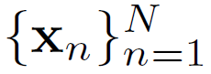
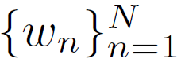
Chain and tree models
Given a set of measurements and world states , infer the world states from the measurements.
Problem: if N is large, then the model relating the two will have a very large number of parameters.
Solution: build sparse models where we only describe subsets of the relations between variables.

Slide 4
Chain and tree models
Chain model: only model connections between a world variable and its 1 preceding and 1 subsequent variables
Tree model: connections between world variables are organized as a tree (no loops). Disregard directionality of connections for directed model

Slide 5
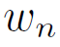
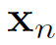
Assumptions
We’ll assume that
World states are discrete
Observe a data variable for each world state
The n^{th} data variable is conditionally independent of all of other data variables and world states, given its associated world state

Slide 6
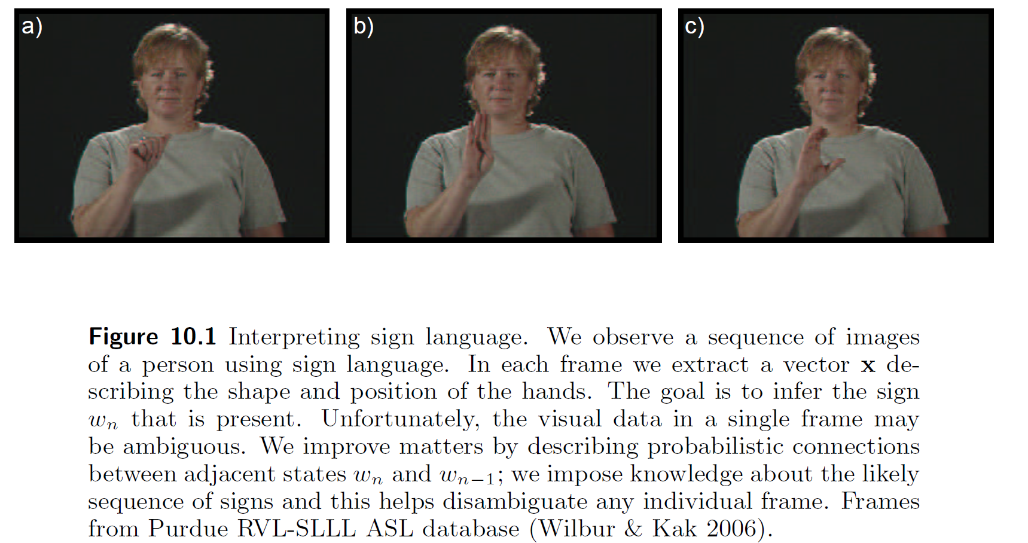
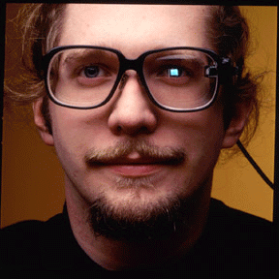
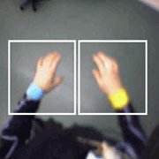
Gesture Tracking
See also: Thad Starner’s work

Slide 7
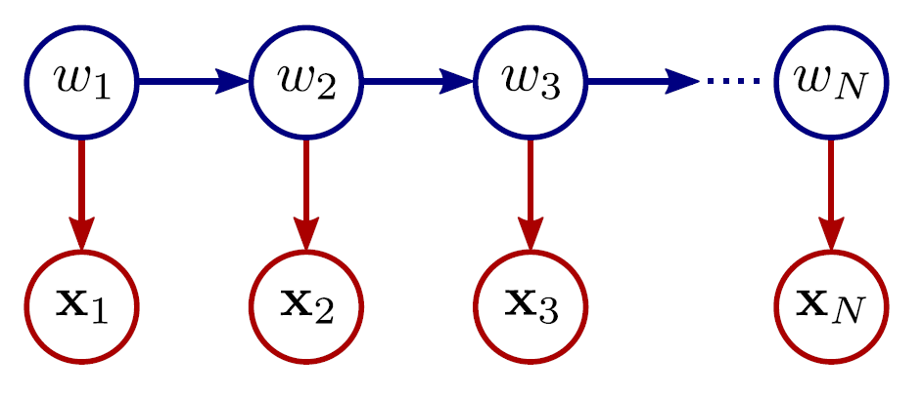
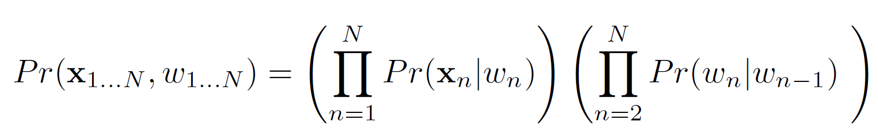
Directed model for chains (Hidden Markov model)
Compatibility of measurement and world state
Compatibility of world state and previous world state

Slide 8
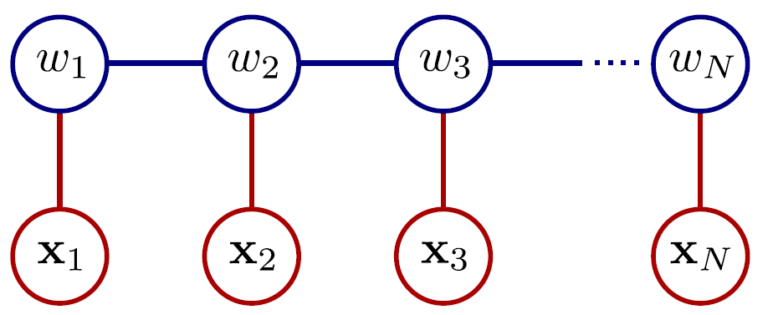
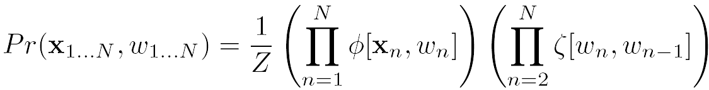
Undirected model for chains
Compatibility of measurement and world state
Compatibility of world state and previous world state

Slide 9
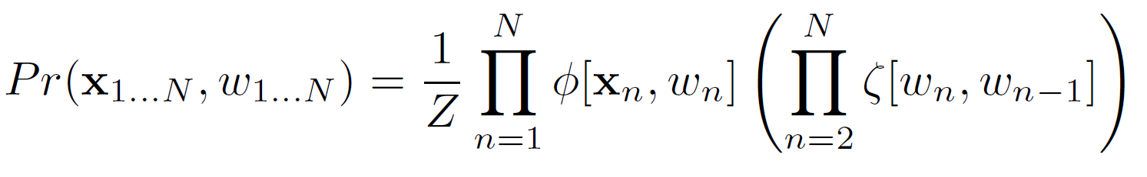
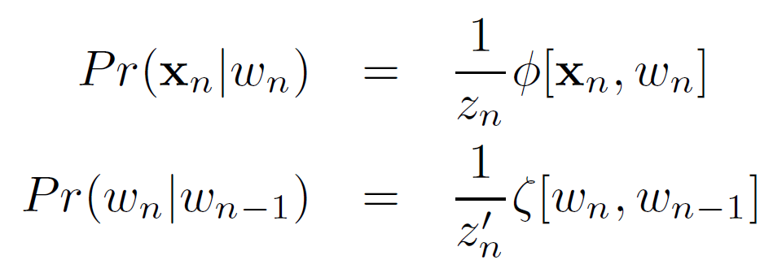
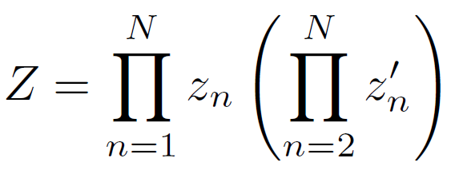
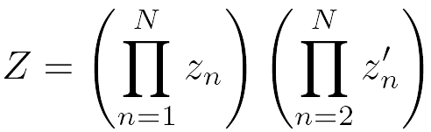
Equivalence of chain models
Directed:
Undirected:
Equivalence:

Slide 10
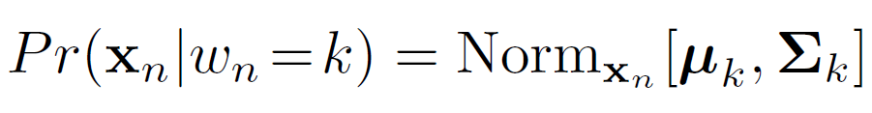
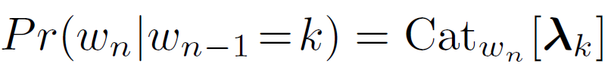
Chain model for sign language application
Observations are normally distributed but depend on sign k
World state is categorically distributed, parameters depend on previous world state

Slide 11
Structure
Chain and tree models
MAP inference in chain models
MAP inference in tree models
Maximum marginals in chain models
Maximum marginals in tree models
Models with loops
Applications
Computer vision: models, learning and inference. ©2011 Simon J.D. Prince
11

Slide 12
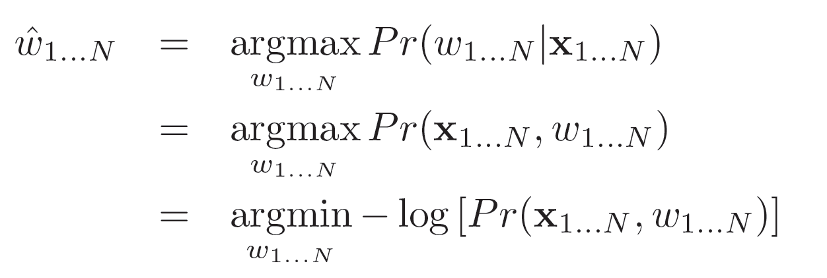
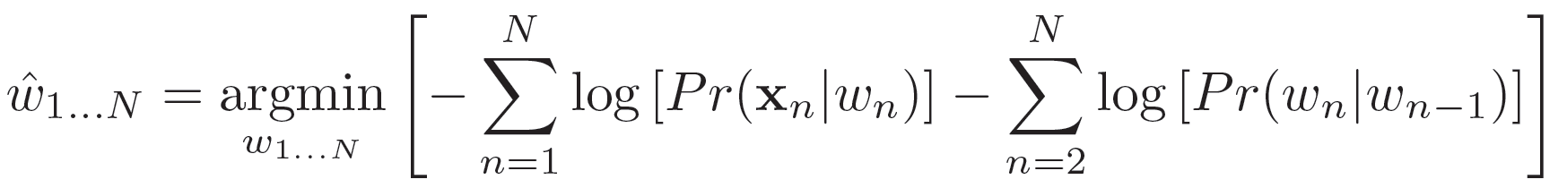
MAP inference in chain model
Directed model:
MAP inference:
Substituting in :

Slide 13
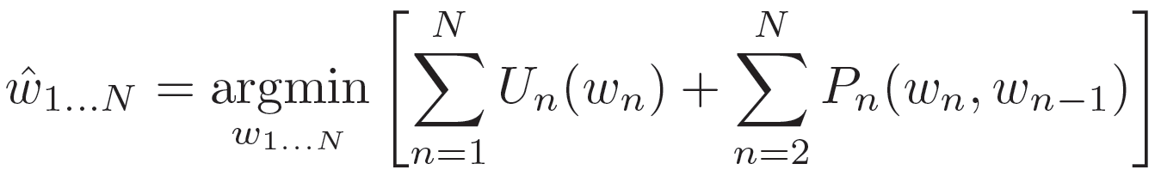
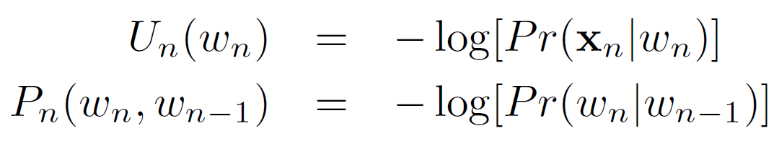













MAP inference in chain model
Takes the general form:
Unary term:
Pairwise term:

Slide 14
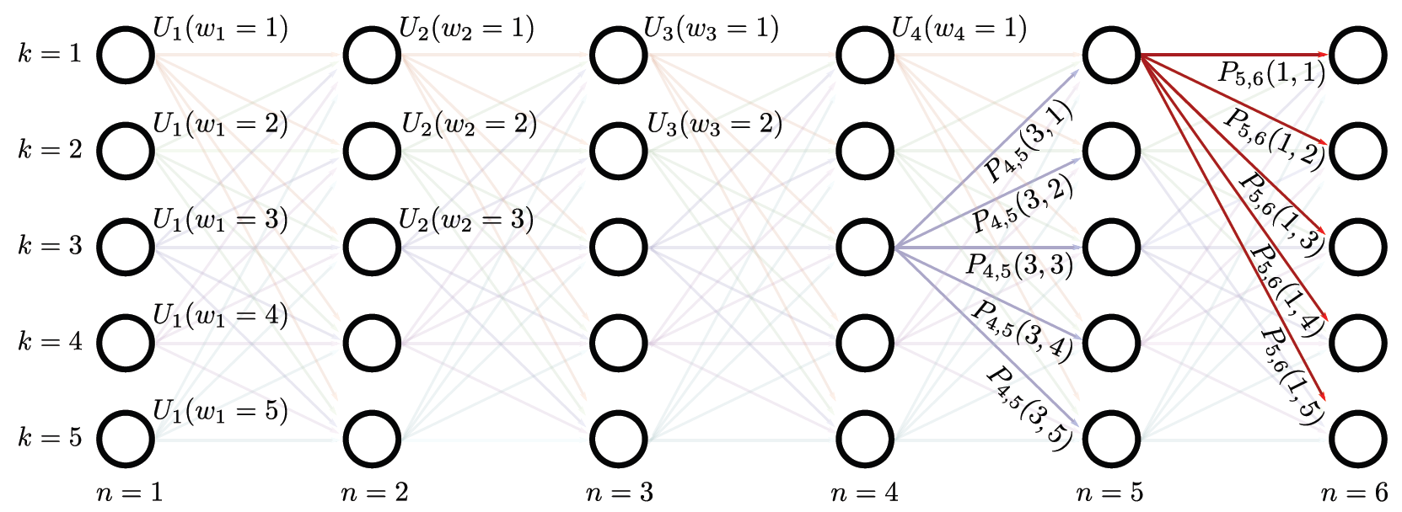
Dynamic programming
Maximizes functions of the form:
Set up as cost for traversing graph – each path from left to right is one possible configuration of world states

Slide 15
Dynamic programming
Maximizes functions of the form:
Set up as cost for traversing graph – each path from left to right is one possible configuration of world states

Slide 16
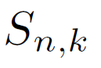
Dynamic programming
Algorithm:
Work through graph computing minimum possible cost to reach each node
When we get to last column, find minimum
Trace back to see how we got there

Slide 17
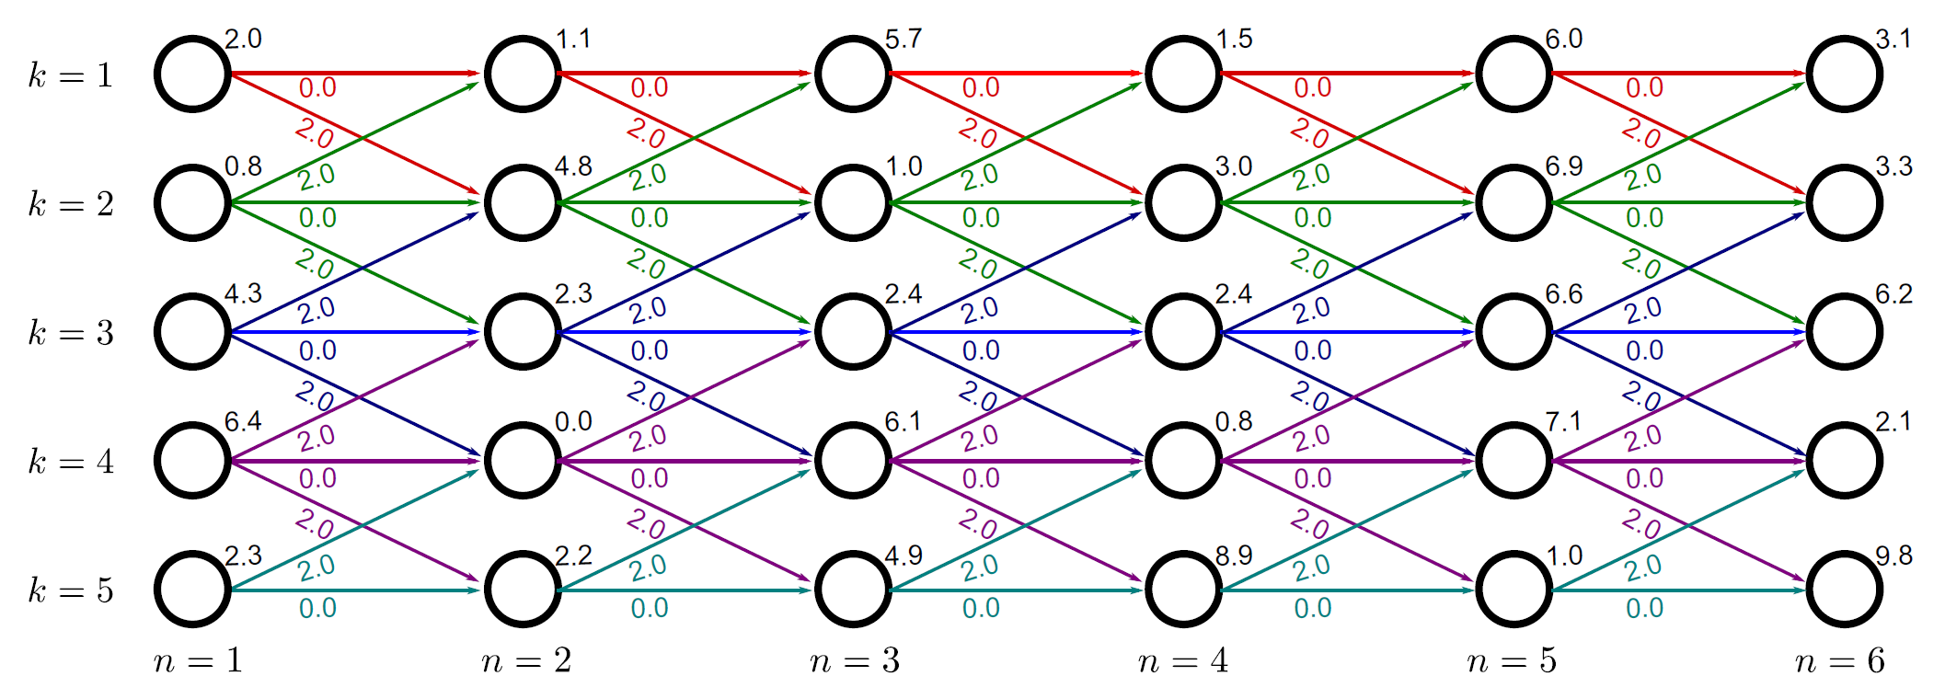

Worked example
Unary cost
Pairwise costs:
Zero cost to stay at same label
Cost of 2 to change label by 1
Infinite cost for changing by more than one (not shown)

Slide 18
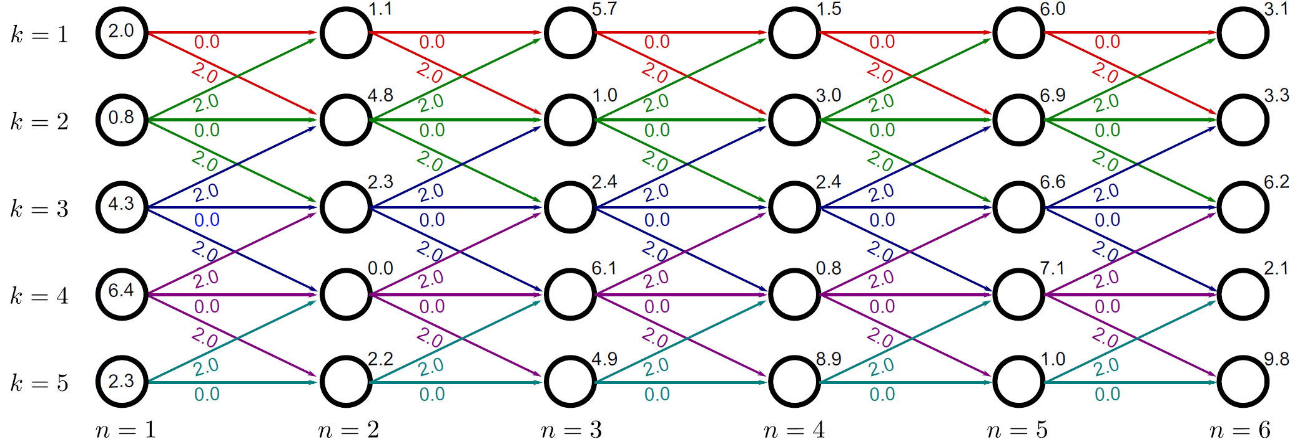
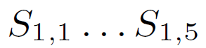
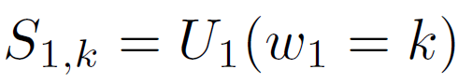
Worked example
Minimum cost
to reach first node is just unary cost

Slide 19
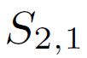
Worked example
Minimum cost is minimum of two possible routes to get here
Route 1: 2.0+0.0+1.1 = 3.1
Route 2: 0.8+2.0+1.1 = 3.9

Slide 20
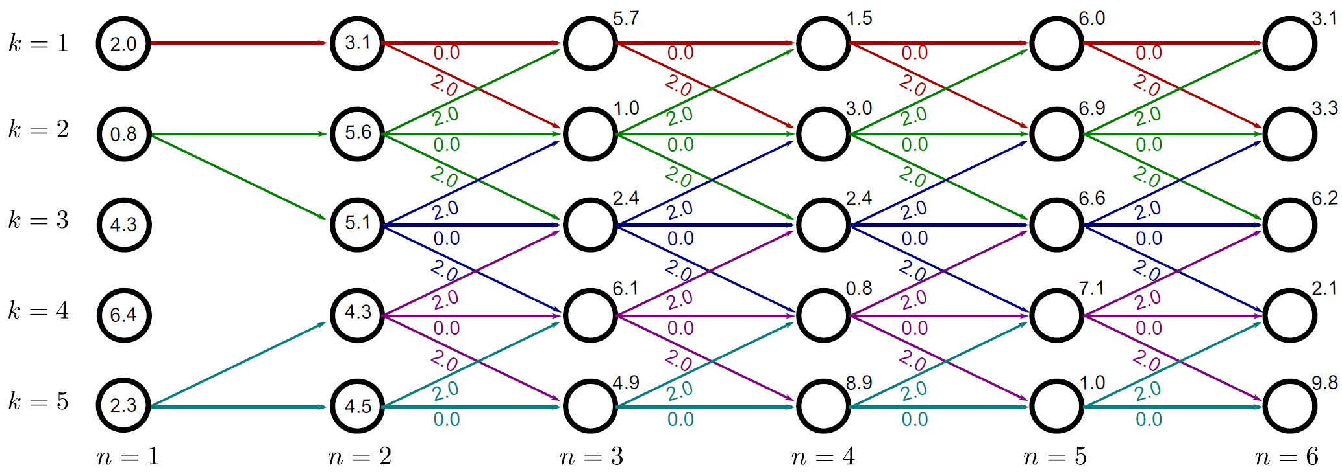
Worked example
Minimum cost is minimum of two possible routes to get here
Route 1: 2.0+0.0+1.1 = 3.1 -- this is the minimum – note this down
Route 2: 0.8+2.0+1.1 = 3.9

Slide 21
Worked example
General rule:

Slide 22
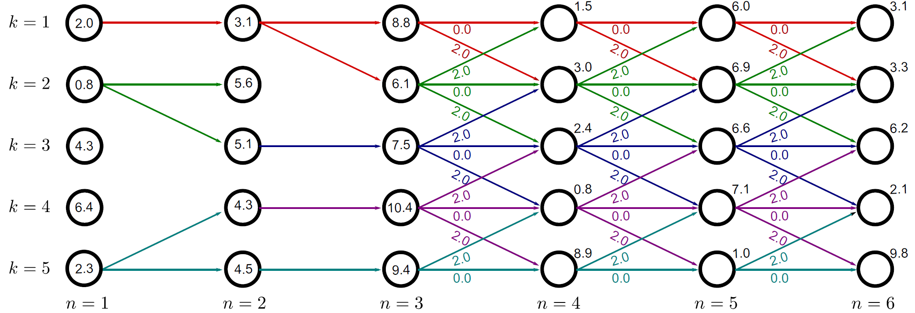
Worked example
Work through the graph, computing the minimum cost to reach each node

Slide 23
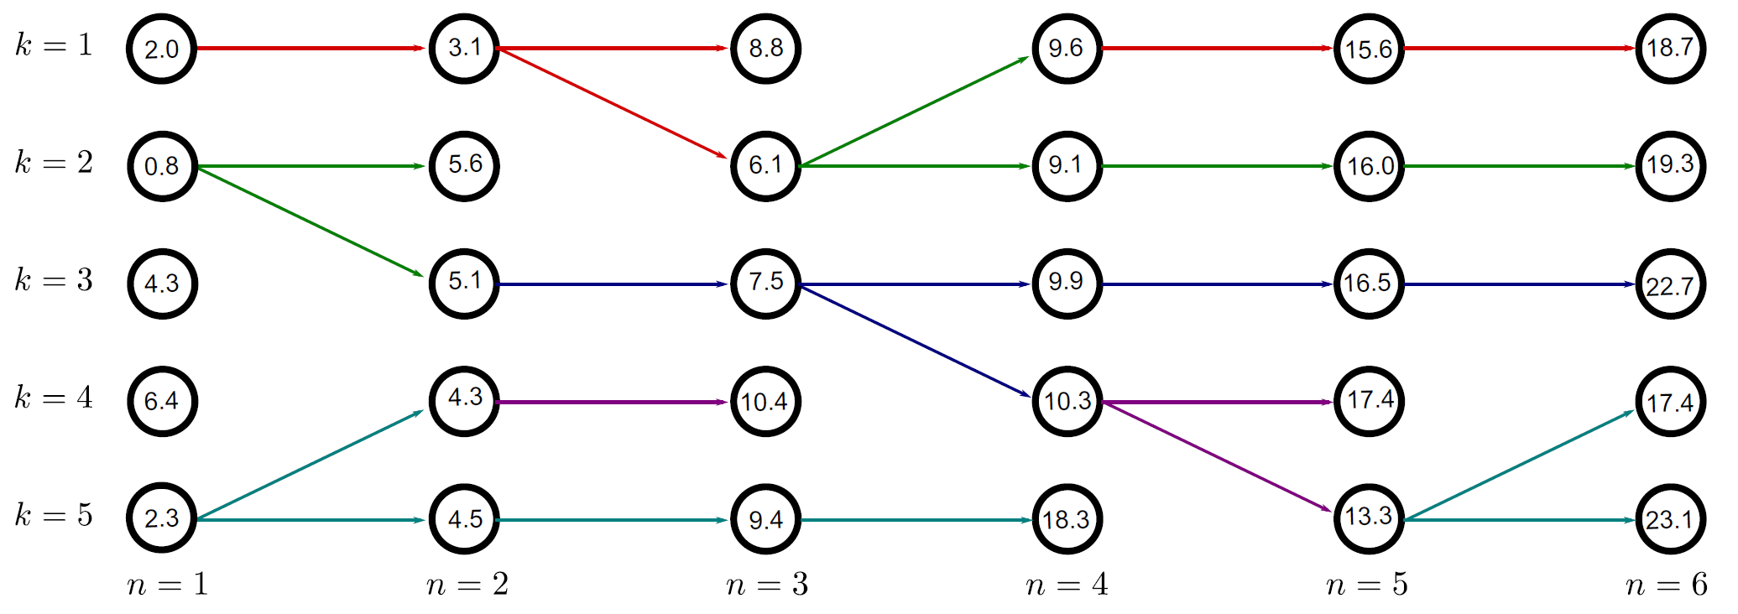


Worked example
Keep going until we reach the end of the graph
这里每个时间轴下，的每个状态都只需要记录上一个parent和value就可以了

Slide 24
Worked example
Find the minimum possible cost to reach the final column

Slide 25
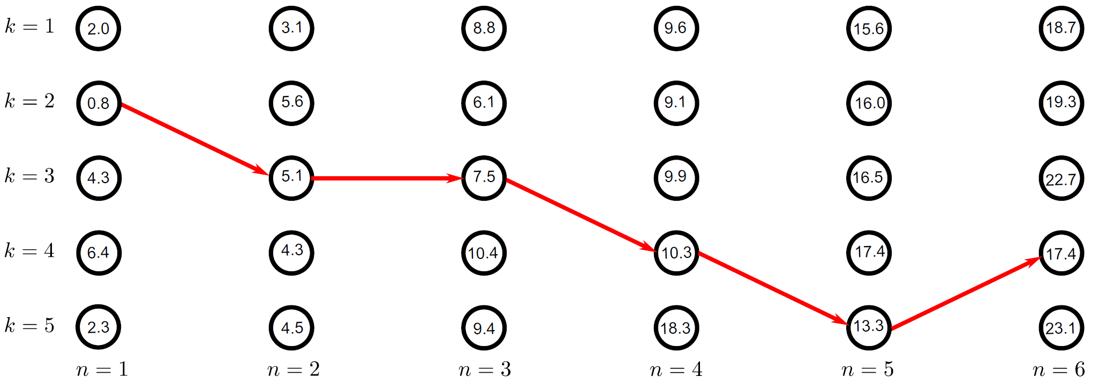
Worked example
Trace back the route by which we arrived here – this is the minimum configuration

Slide 26
Structure
Chain and tree models
MAP inference in chain models
MAP inference in tree models
Maximum marginals in chain models
Maximum marginals in tree models
Models with loops
Applications
Computer vision: models, learning and inference. ©2011 Simon J.D. Prince
26

Slide 27
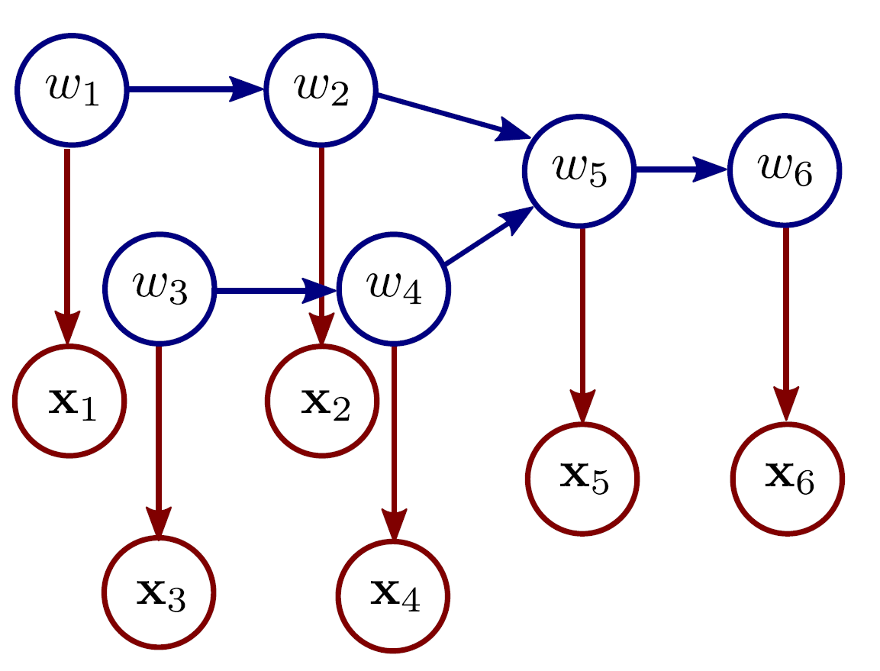
MAP inference for trees

Slide 28
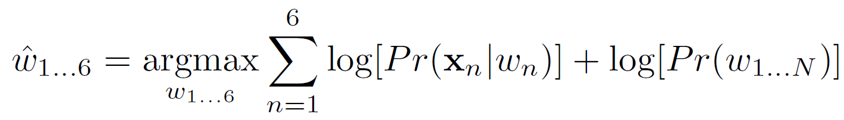

MAP inference for trees

Slide 29
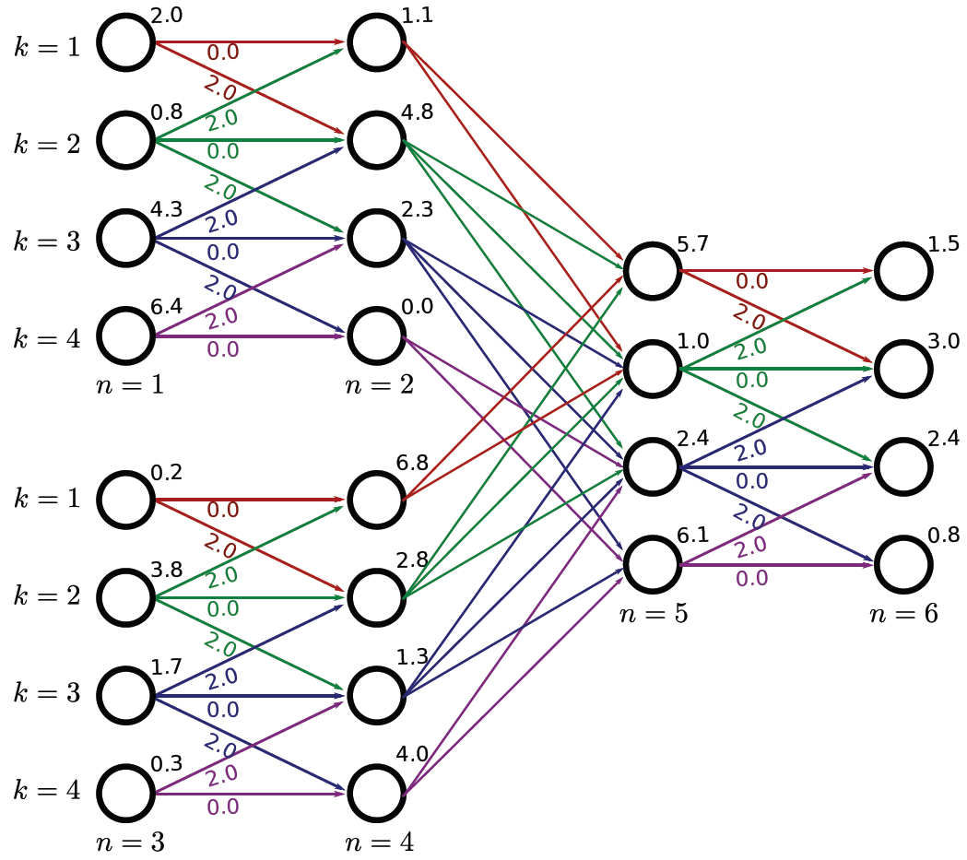
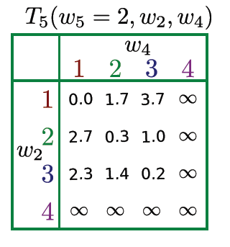
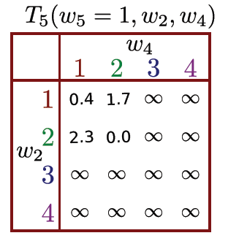
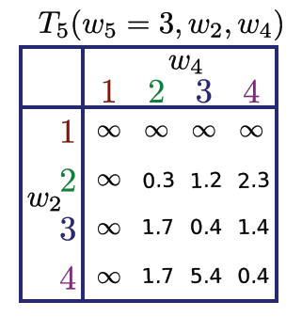
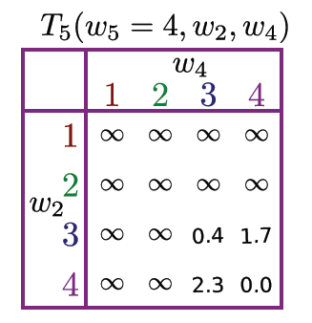






Worked example
因为5可能来自于12这条路或者34这条路

Slide 30
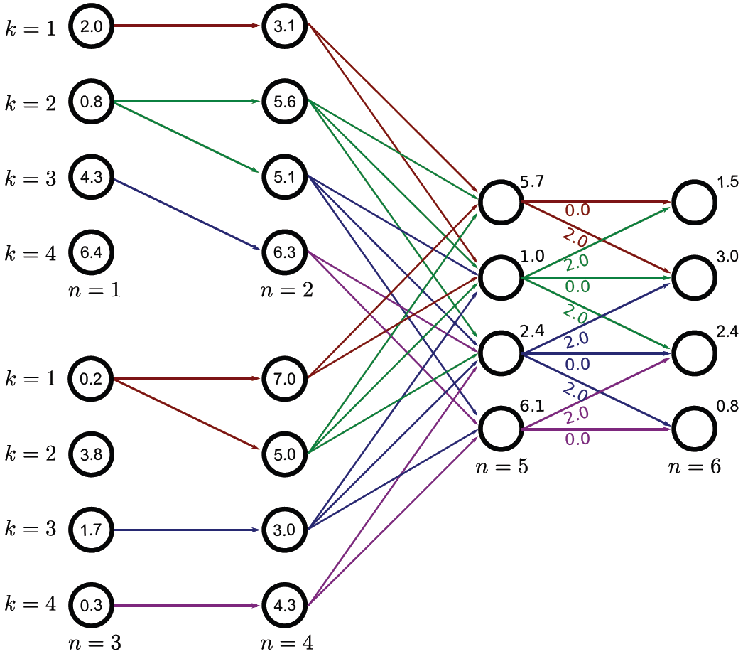
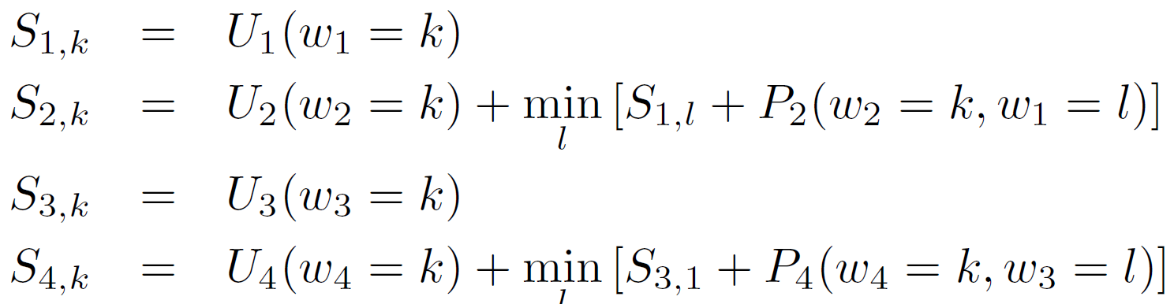



Worked example
Variables 1-4 proceed as for the chain example.

Slide 31
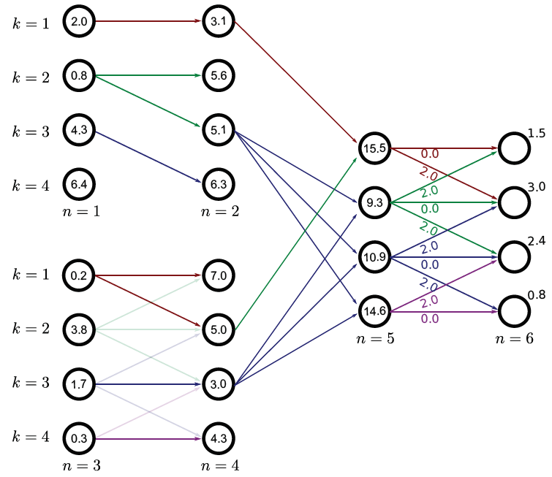
Worked example
At variable n=5 must consider all pairs of paths from into the current node.
N = 5时，16种状态里找最小的

Slide 32
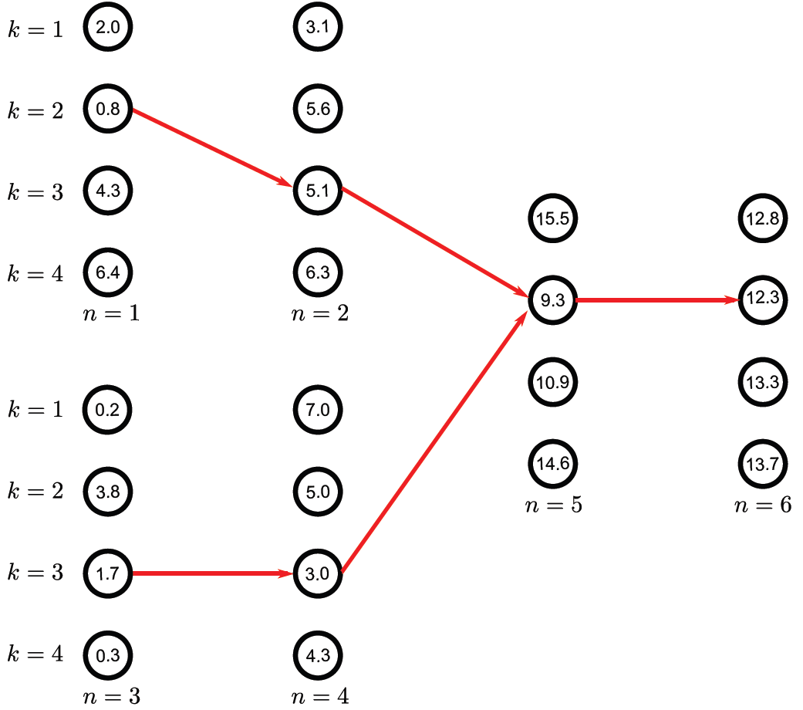
Worked example
Variable 6 proceeds as normal.
Then we trace back through the variables, splitting at the junction.

Slide 33







Structure
Chain and tree models
MAP inference in chain models
MAP inference in tree models
Maximum marginals in chain models
Maximum marginals in tree models
Models with loops
Applications
Computer vision: models, learning and inference. ©2011 Simon J.D. Prince
33

Slide 34
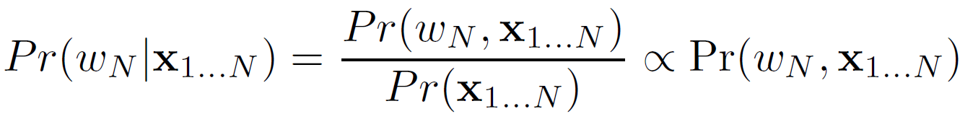
Marginal posterior inference
Start by computing the marginal distribution over the N^{th} variable
Then we`ll consider how to compute the other marginal distributions

Slide 35
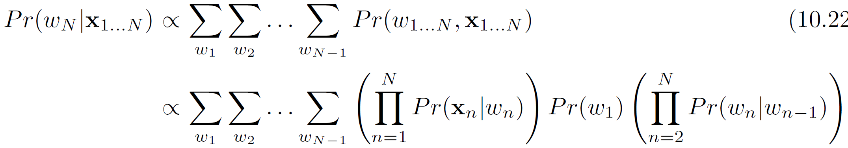
Computing one marginal distribution
Compute the posterior using Bayes` rule:
We compute this expression by writing the joint probability :

Slide 36
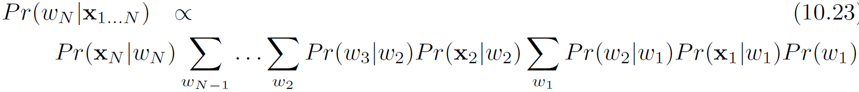
Computing one marginal distribution
Problem: Computing all N^{K} states and marginalizing explicitly is intractable.
Solution: Re-order terms and move summations to the right

Slide 37
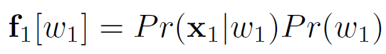
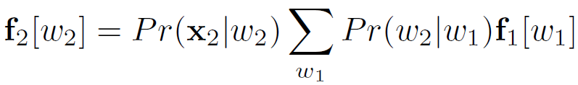
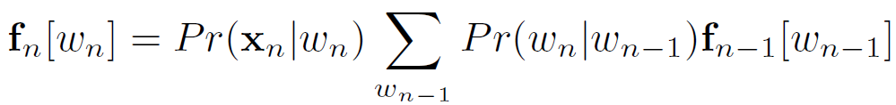
Computing one marginal distribution
Define function of variable w₁ (two rightmost terms)
Then compute function of variables w₂ in terms of previous function
Leads to the recursive relation

Slide 38
Computing one marginal distribution
We work our way through the sequence using this recursion.
At the end we normalize the result to compute the posterior
Total number of summations is (N-1)K as opposed to K^{N} for brute force approach.

Slide 39
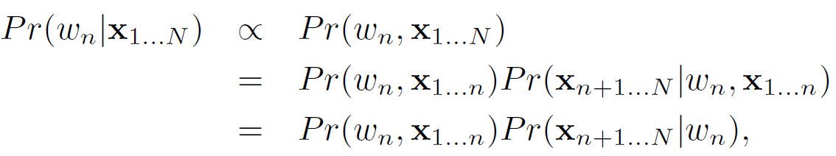
Forward-backward algorithm
We could compute the other N-1 marginal posterior distributions using a similar set of computations
However, this is inefficient as much of the computation is duplicated
The forward-backward algorithm computes all of the marginal posteriors at once
Solution:
... and take products
Compute all first term using a recursion
Compute all second terms using a recursion

Slide 40


Forward recursion
Conditional probability rule
Using conditional independence relations
This is the same recursion as before

Slide 41


Backward recursion
Conditional probability rule
Using conditional independence relations
This is another recursion of the form

Slide 42
Forward backward algorithm
Compute the marginal posterior distribution as product of two terms
Forward terms:
Backward terms:

Slide 43
Belief Propagation
BP在因子图上的应用
在因子图上使用BP算法时，每个变量节点会向其相邻的因子节点发送一条包含其当前概率估计的消息。反过来，因子节点收到来自所有相连变量节点的消息后，根据这些输入计算出一个新的输出消息，再发送回这些变量节点。这个过程不断迭代，直到所有消息稳定下来，最终得到每个变量的概率分布。
Forward backward algorithm is a special case of a more general technique called belief propagation
Intermediate functions in forward and backward recursions are considered as messages conveying beliefs about the variables.
We’ll examine the Sum-Product algorithm for BP.
The Sum-Product algorithm operates on factor graphs.

Slide 44

Factor graphs
One node for each variable
One node for each function relating variables

Slide 45
Sum product algorithm
Forward pass
Distribute evidence through the graph
Backward pass
Collates the evidence
Both phases involve passing messages between nodes:
The forward phase can proceed in any order as long as the outgoing messages are not sent until all incoming ones received
Backward phase proceeds in reverse order to forward

Slide 46
Sum product algorithm
Three kinds of message
Messages from unobserved variables to functions
Messages from observed variables to functions
Messages from functions to variables

Slide 47


Sum product algorithm
Message type 1:
Messages from unobserved variables z to function g
Take product of incoming messages
Interpretation: combining beliefs
Message type 2:
Messages from observed variables z to function g
Interpretation: conveys certain belief that observed values are true

Slide 48


Sum product algorithm
Message type 3:
Messages from a function g to variable z
Takes beliefs from all incoming variables except recipient and uses function g to a belief about recipient
Computing marginal distributions:
After forward and backward passes, we compute the marginal dists as the product of all incoming messages

Slide 49


Sum product: forward pass
Message from x₁ to g₁:
By rule 2:

Slide 50

Sum product: forward pass
Message from g₁ to w₁:
By rule 3:

Slide 51

Sum product: forward pass
Message from w₁ to g_{1,2}:
By rule 1:
(product of all incoming messages)

Slide 52

Sum product: forward pass
Message from g_{1,2} from w₂:
By rule 3:

Slide 53

Sum product: forward pass
Messages from x₂ to g₂ and g₂ to w₂:

Slide 54

Sum product: forward pass
Message from w₂ to g_{2,3}:
The same recursion as in the forward backward algorithm

Slide 55
Sum product: forward pass
Message from w₂ to g_{2,3}:

Slide 56

Sum product: backward pass
Message from w_{N} to g_{N,N-1}:

Slide 57

Sum product: backward pass
Message from g_{N,N-1} to w_{N-1}:

Slide 58
Sum product: backward pass
Message from g_{n,n-1} to w_{n-1}:
The same recursion as in the forward backward algorithm

Slide 59


Sum product: collating evidence
Marginal distribution is products of all messages at node
Proof:

Slide 60
Structure
Chain and tree models
MAP inference in chain models
MAP inference in tree models
Maximum marginals in chain models
Maximum marginals in tree models
Models with loops
Applications
Computer vision: models, learning and inference. ©2011 Simon J.D. Prince
60

Slide 61

Marginal posterior inference for trees
Apply sum-product algorithm to the tree-structured graph.

Slide 62
Structure
Chain and tree models
MAP inference in chain models
MAP inference in tree models
Maximum marginals in chain models
Maximum marginals in tree models
Models with loops
Applications
Computer vision: models, learning and inference. ©2011 Simon J.D. Prince
62

Slide 63




Tree structured graphs
马尔可夫链：通常表示一维的序列依赖，每个状态只依赖于它的直接前驱。
因子图：可以表示更复杂的多维依赖关系，不仅限于序列或链状结构。
这里三个函数都变成一个节点了欸
This graph contains loops
But the associated factor graph has structure of a tree
Can still use Belief Propagation

Slide 64
Learning in chains and trees
Supervised learning (where we know world states w_{n}) is relatively easy.
Unsupervised learning (where we do not know world states w_{n}) is more challenging. Use the EM algorithm:
E-step – compute posterior marginals over states
M-step – update model parameters
For the chain model (hidden Markov model) this is known as the Baum-Welch algorithm.

Slide 65

Grid-based graphs
Often in vision, we have one observation associated with each pixel in the image grid.

Slide 66



Why not dynamic programming?
这里如果用dp
从后往前推导会发现第一个时刻对应两种状态了
即不converge
When we trace back from the final node, the paths are not guaranteed to converge.

Slide 67

Why not dynamic programming?

Slide 68
Why not dynamic programming?
But:

Slide 69




Approaches to inference for grid-based models
Prune the graph.
Remove edges until an edge remains

Slide 70




Approaches to inference for grid-based models
2. Combine variables.
Merge variables to form compound variable with more states until what remains is a tree. Not practical for large grids

Slide 71








Approaches to inference for grid-based models
3. Loopy belief propagation.
Just apply belief propagation. It is not guaranteed to converge, but in practice it works well.
4. Sampling approaches
Draw samples from the posterior (easier for directed models)
Other approaches
Tree-reweighted message passing
Graph cuts

Slide 72
Structure
Chain and tree models
MAP inference in chain models
MAP inference in tree models
Maximum marginals in chain models
Maximum marginals in tree models
Models with loops
Applications
Computer vision: models, learning and inference. ©2011 Simon J.D. Prince
72

Slide 73


Gesture Tracking

Slide 74

















Stereo vision
Two image taken from slightly different positions
Matching point in image 2 is on same scanline as image 1
Horizontal offset is called disparity
Disparity is inversely related to depth
Goal – infer disparities w_{m,n} at pixel m,n from images x⁽¹⁾ and x⁽²⁾
Use likelihood:

Slide 75


Stereo vision

Slide 76


Stereo vision
1. Independent pixels

Slide 77

Stereo vision
2. Scanlines as chain model (hidden Markov model)

Slide 78
Stereo vision
3. Pixels organized as tree (from Veksler 2005)

Slide 79


Pictorial Structures

Slide 80


Pictorial Structures

Slide 81


Segmentation

Slide 82
Conclusion
For the special case of chains and trees we can perform MAP inference and compute marginal posteriors efficiently.
Unfortunately, many vision problems are defined on pixel grid – this requires special methods

